Slide 1
Environmental Law Research
(the quick version)

Slide 2
Sources of Environmental Law
National Environmental Policy Act of 1969 (NEPA)
Clean Air Act of 1970 (CAA)
Clean Water Act (CWA)
Comprehensive Environmental Response, Compensation, and Liability Act of1980 (CERCLA)
o Endangered Species Act of 1973 (ESA)
o Federal Insecticide, Fungicide, and Rodenticide Act (FIFRA)
o Marine Protection, Research, and Sanctuaries Act of 1972 (MPRSA)
o Oil Pollution Act of 1990 (OPA)
o Resource Conservation and Recovery Act of 1976 (RCRA)
o Safe Drinking Water Act of 1974 (SDWA)
o Toxic Substances Control Act of 1976 (TSCA)

Slide 3
Agencies Regulating Env. Law
Environmental Protection Agency (http://www.epa.gov/)
Department of the Interior (http://www.doi.gov/index.cfm)
  Bureau of Land Management (BLM) (http://www.blm.gov/wo/st/en.html)
  Bureau of Indian Affairs (BIA) (http://www.bia.gov/)
  Bureau of Ocean Energy Management (BOEM) (http://www.boem.gov/)
Bureau of Safety and Environmental Enforcement (BSEE)(http://www.bsee.gov/)
U.S. Fish and Wildlife Service (http://www.fws.gov/)
Council on Environmental Quality (CEQ) (http://www.whitehouse.gov/administration/eop/ceq)
National Oceanic and Atmospheric Administration (NOAA) (http://www.noaa.gov/ )
Agency for Toxic Substances and Disease Registry (ATSDR)
(http://www.atsdr.cdc.gov/substances/index.asp
Occupational Safety & Health Review Commission (http://www.oshrc.gov/ )
Department of Energy’s Office of Environmental Management
(http://energy.gov/em/office-environmental-management )
U.S. Justice Department, Environment and Natural Resources Division
(http://www.justice.gov/enrd/)

Slide 4
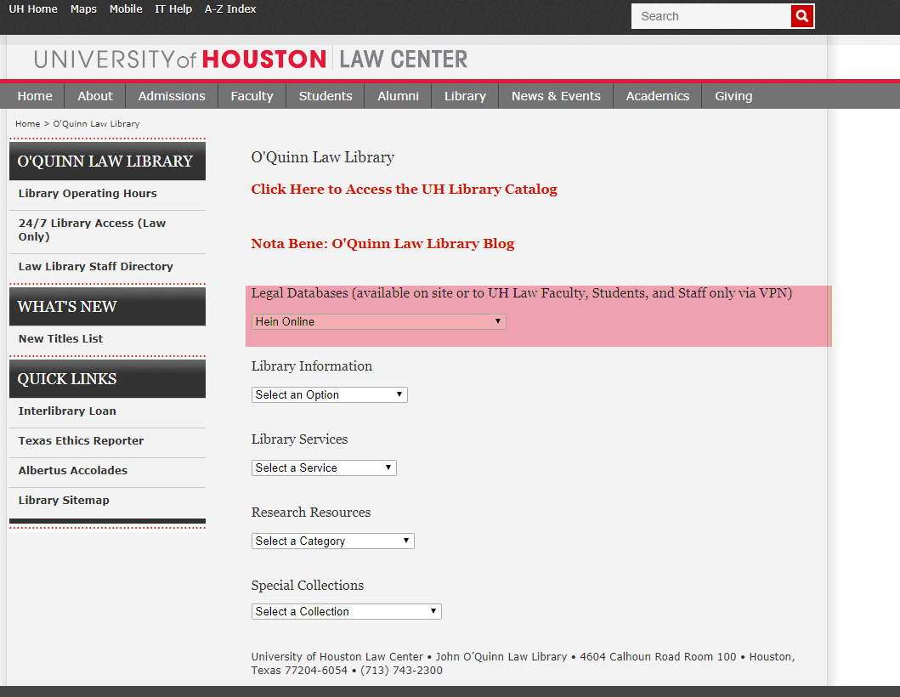
Researching Regulations
Westlaw, Lexis, and Bloomberg all have content, but HeinOnline is the easiest to use.

Slide 5
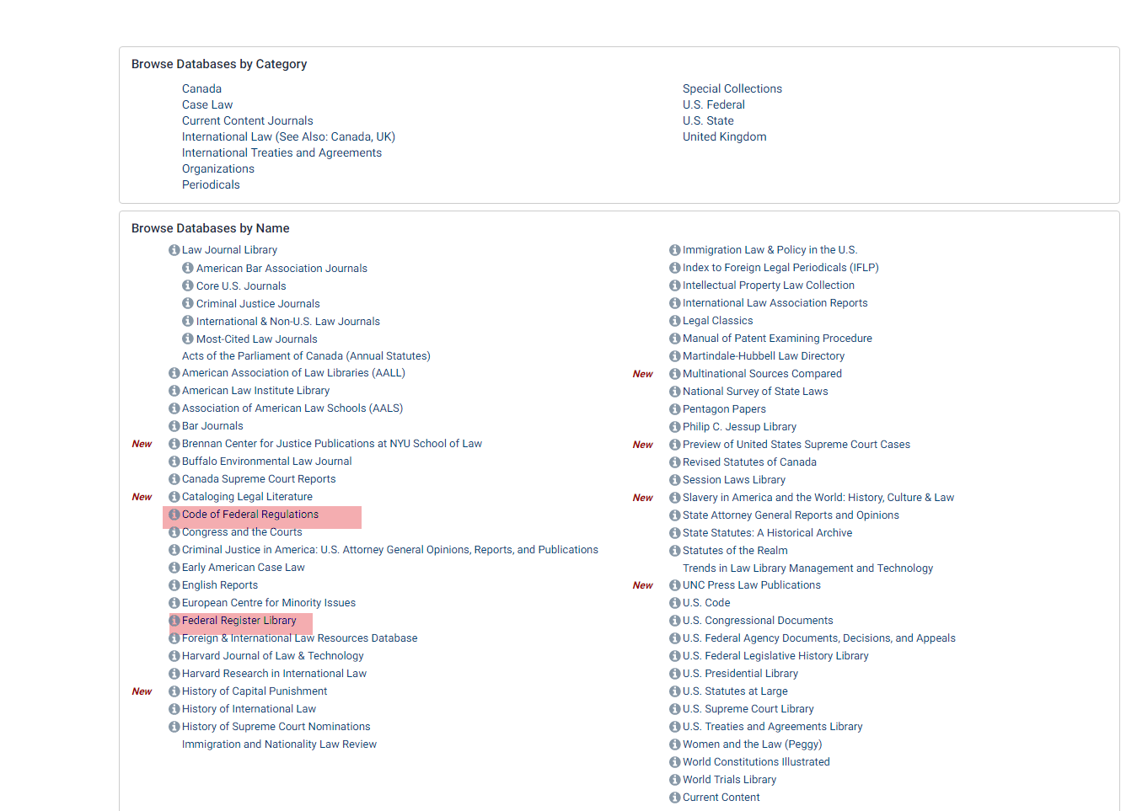
Researching Regulations

Slide 6
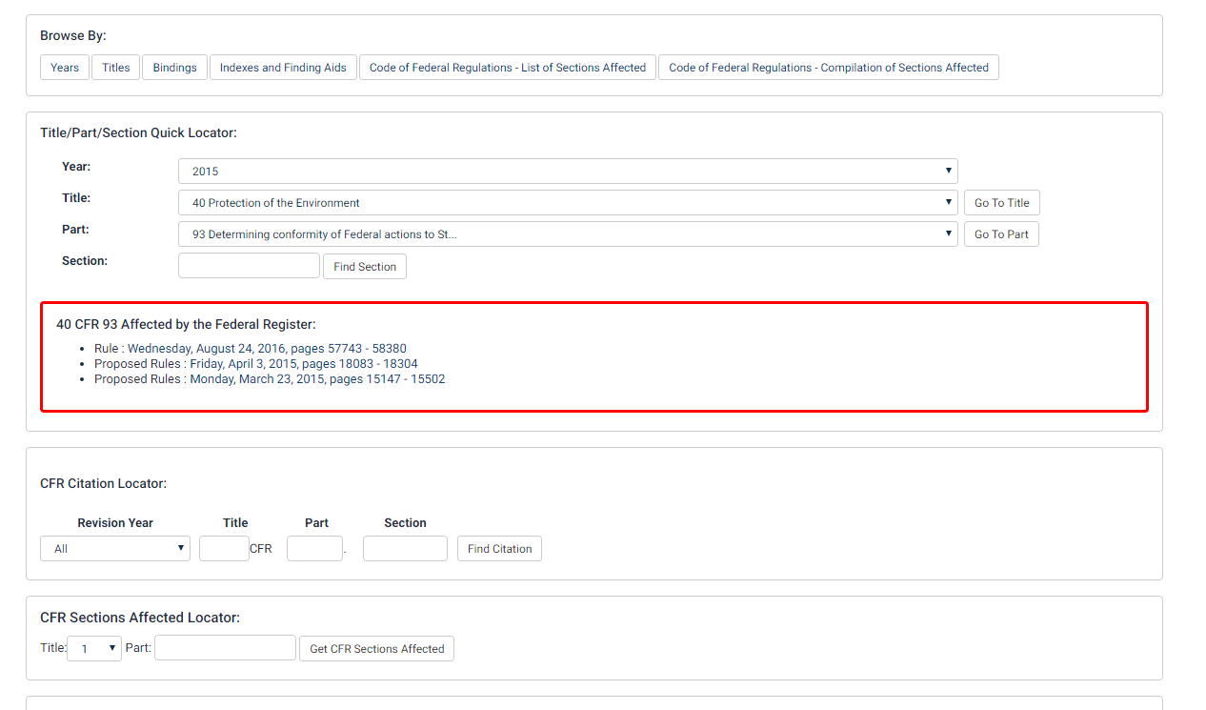
Finding CFR Sections and Changes
Notes:
Hazardous Waste Disposal/ Disposal of Coal Combustion Residuals from Electric Utilities/Extension of Compliance Deadline

Slide 7
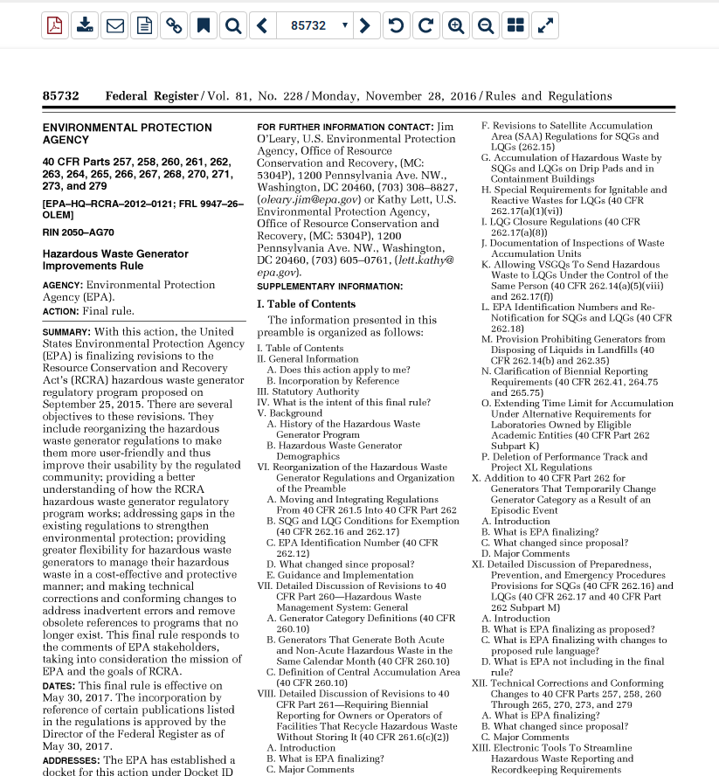
Finding CFR Sections & Changes

Slide 8
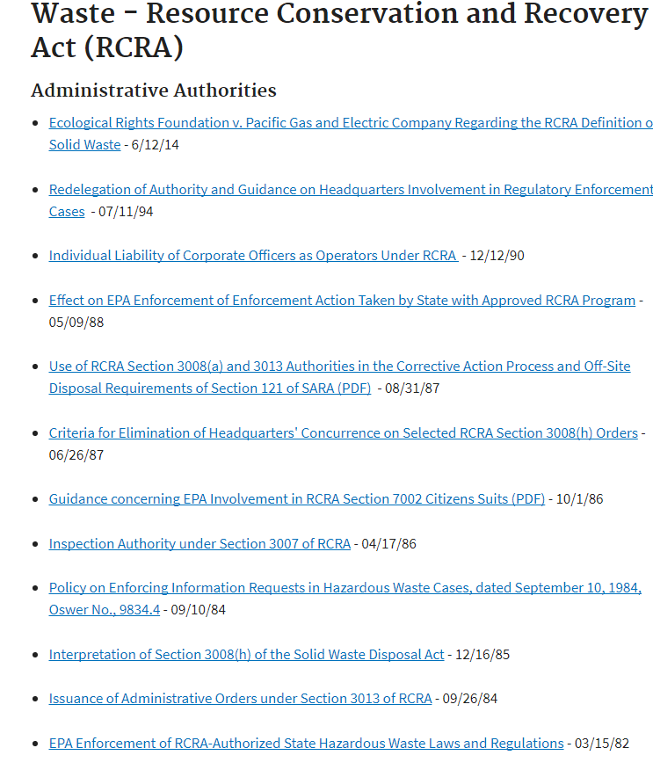
Use Agency Websites to Find. . .
Laws
Regulations
Policy Guidance
Compliance
Enforcement
Data

Slide 9
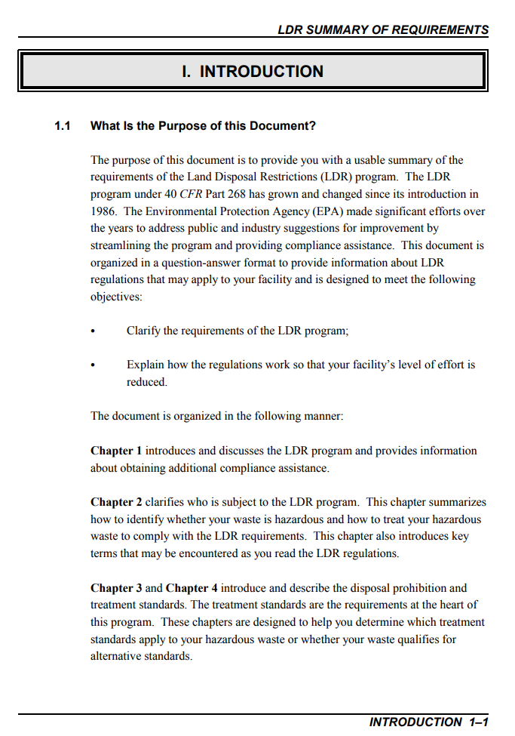
Policy Guidance

Slide 10
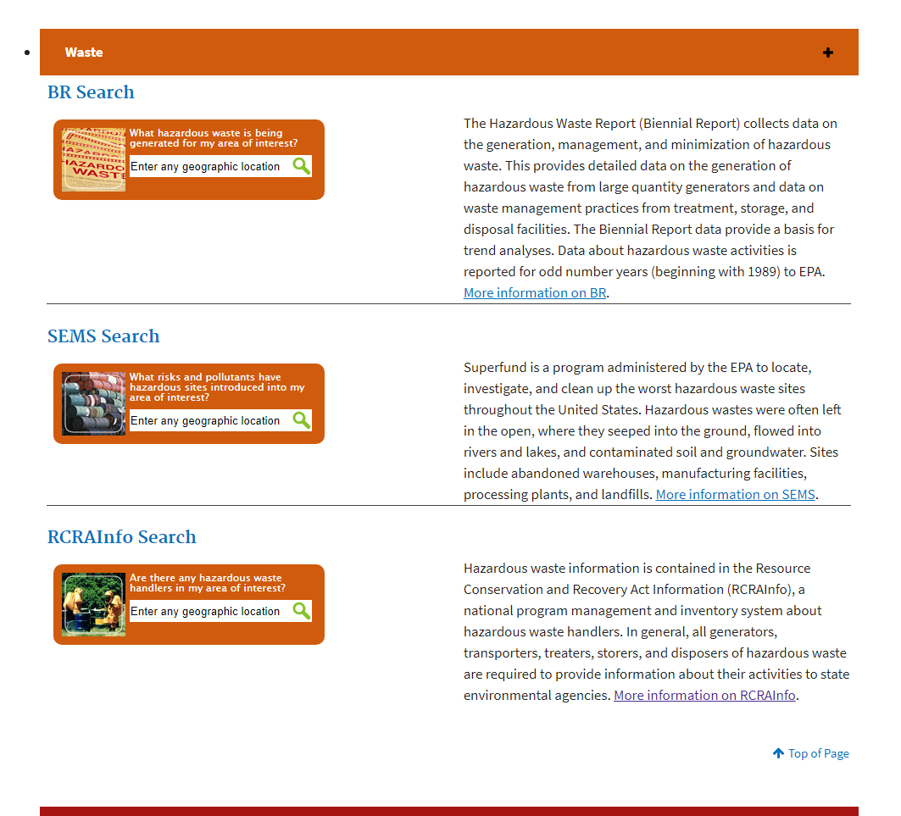
Agency Data

Slide 11
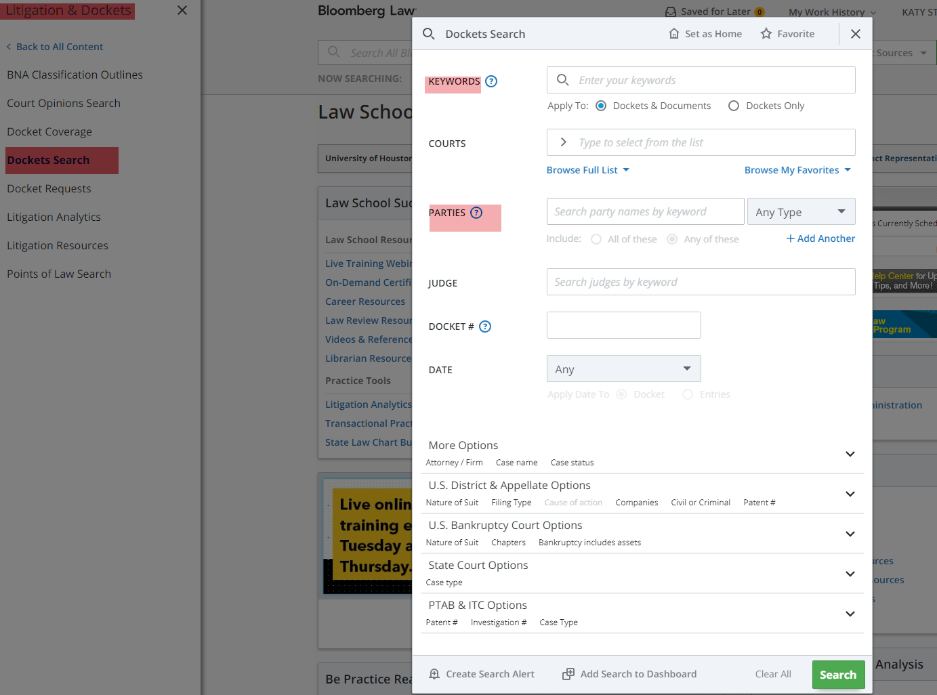
Current Litigation & Court Filings
Best search features and access through Bloomberg Law

Slide 12
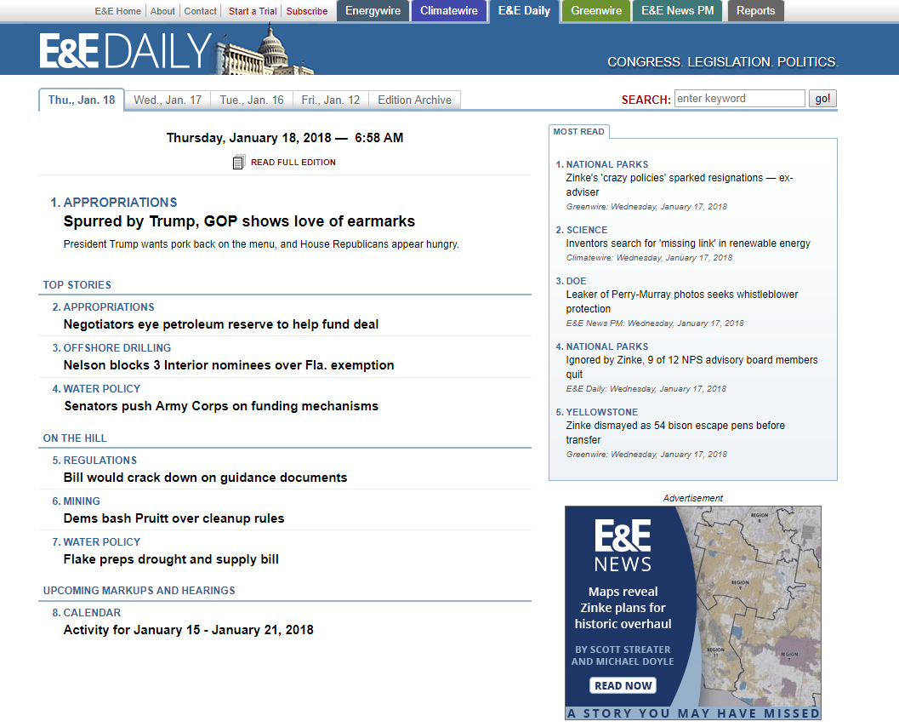
Secondary Sources
See Research Guide linked on Course Syllabus

Slide 13
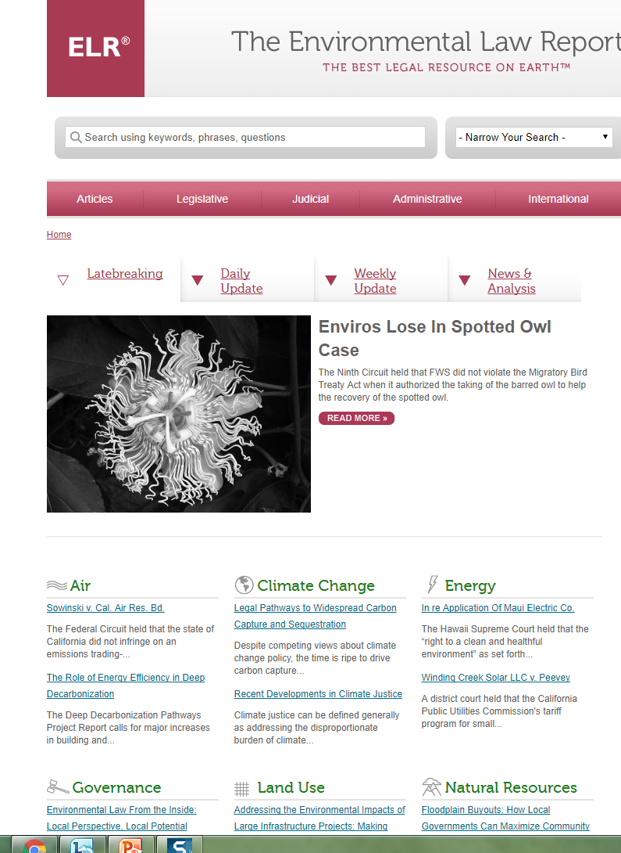
Environmental Law Reporter

Slide 14
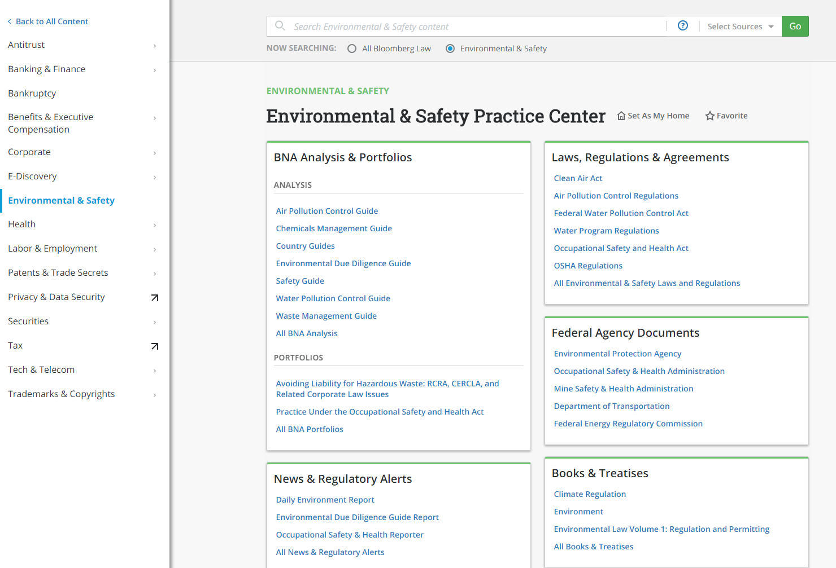
BNA Environmental Practice Center

Slide 15
Please stop by my office or the Library Reference Desk anytime for research assistance.
Katy Badeaux, Faculty Services Librarian
kastein@central.uh.edu
Office- Law Library 14

